Slide 1
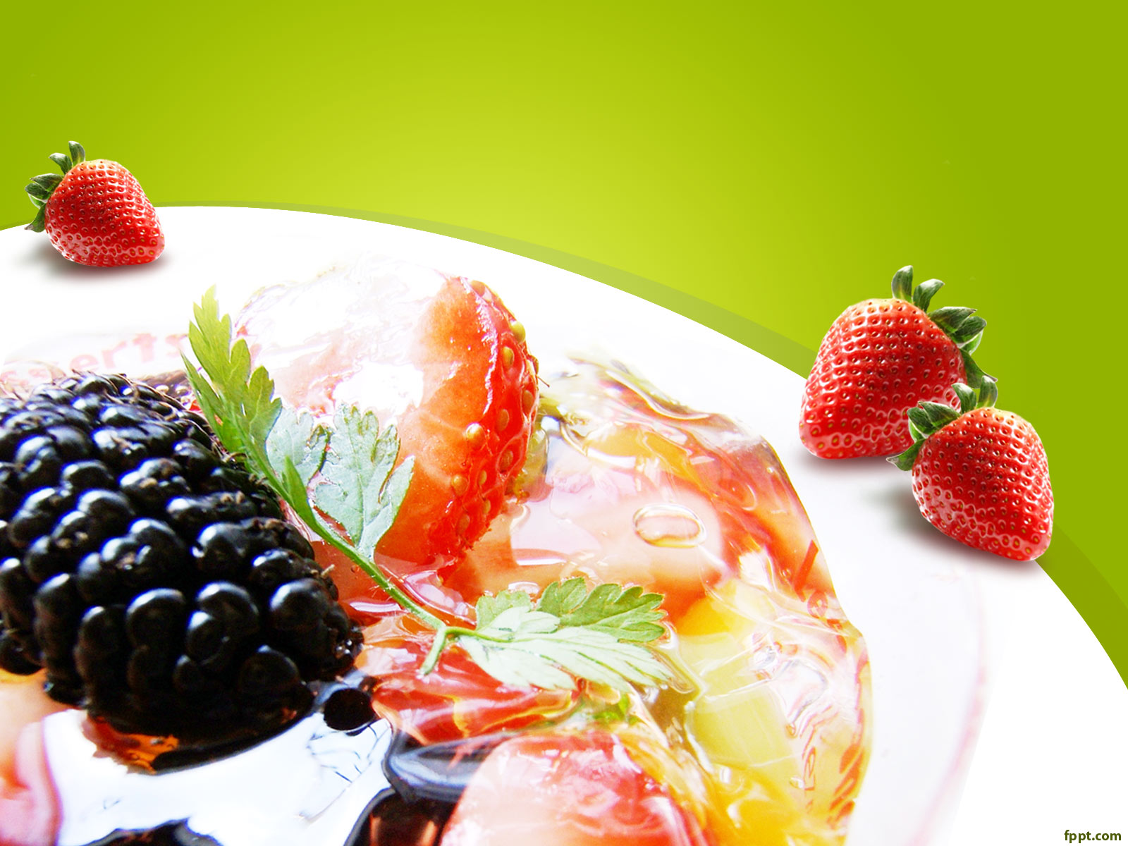
Qyksa ds uke

Slide 2
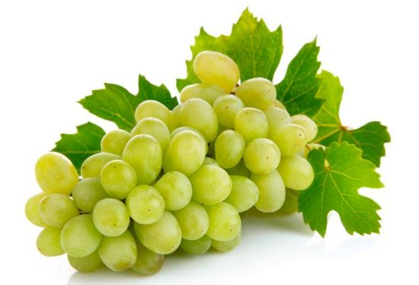
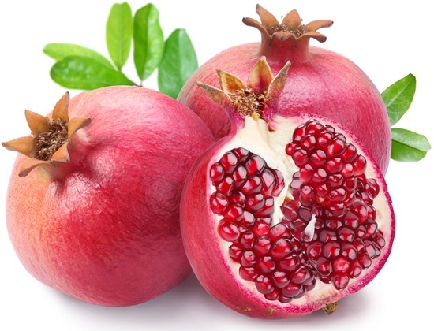
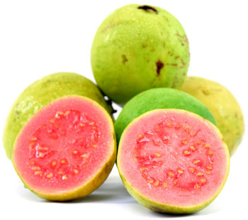
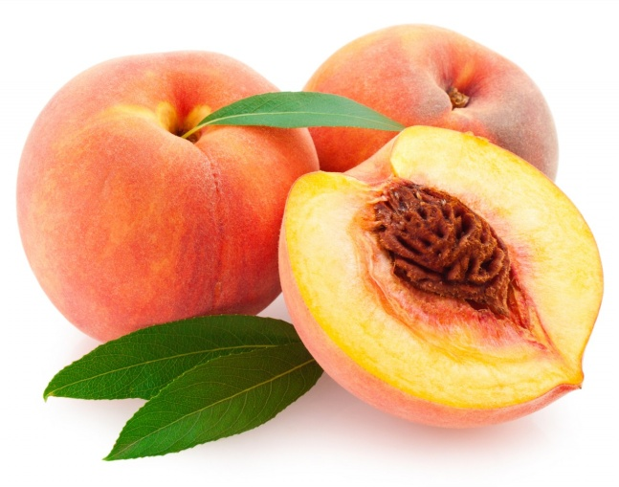
nkfMee~
vukj
fuchZte~
vaxwj
vkezye~
ve:n
vkgzkyq
vkMw

Slide 3

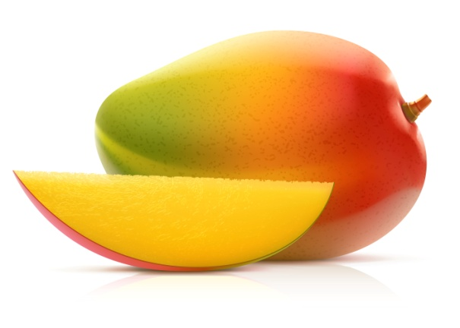
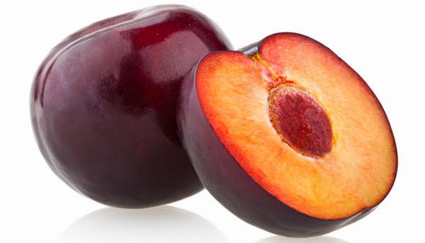
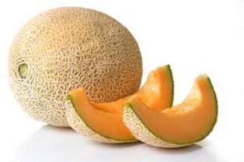
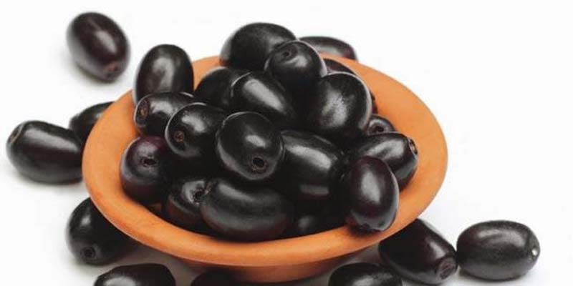
vkeze~~
vke
vkyqde~
Vkywcq[kkjk
[kcqZte~~
[kjcqtk
tEcwQye~~
tkequ

Slide 4
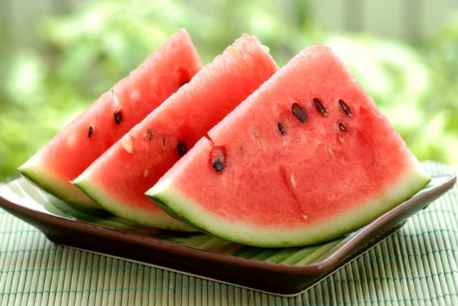
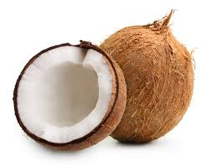
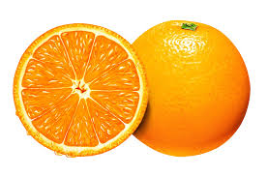
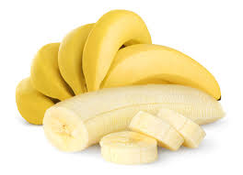
rjcwte~
rjcwt
ukfjdsye~
Ukkfj;y
ukajxe~
larjk] ukjaxh
ekrqyqax
dsyk

Slide 5
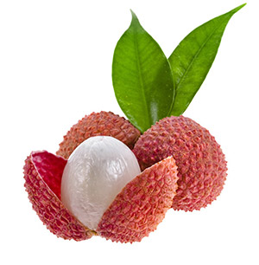
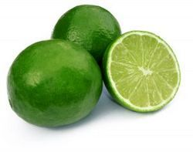
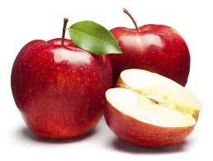
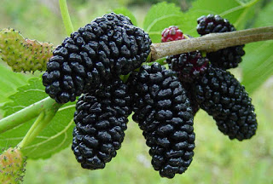
ekrqyqax%
ekSleh
yhfpdk
yhph
lsoe~
lsc
rwre
'kgrwr

Slide 6
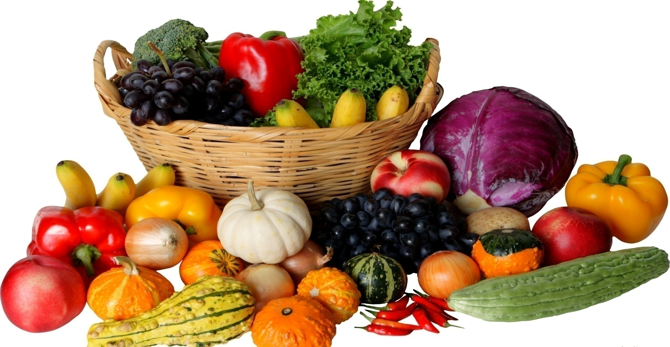
lfCt;ksa ds uke

Slide 7
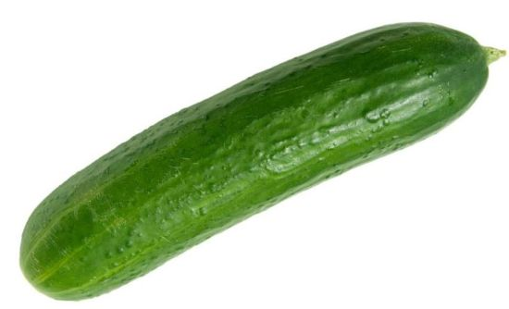
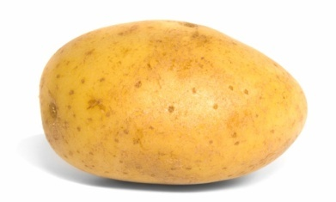
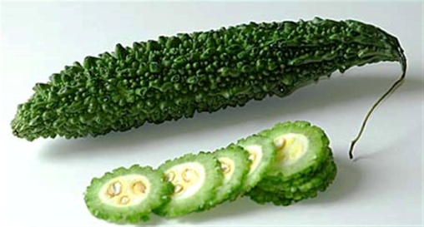

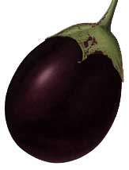
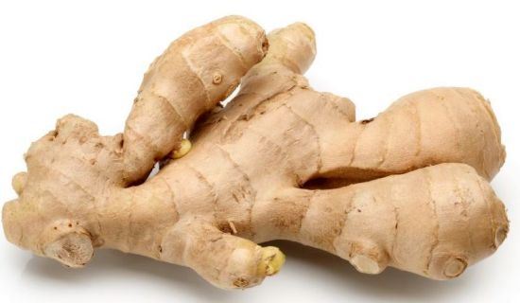
pHkZfV%
[khjk
vkyq%
vkyw
dkjosYye~
djsyk
x`tue~%
xktj
vknzZde~
vnjd
Hk.Vkdh oaxu%
cSaxu

Slide 8
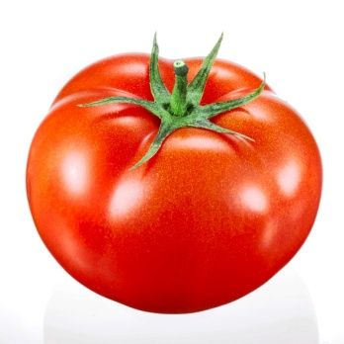
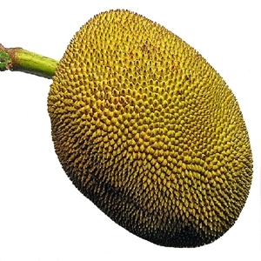
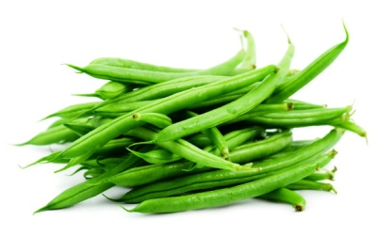
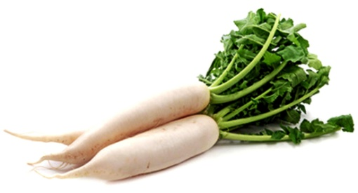
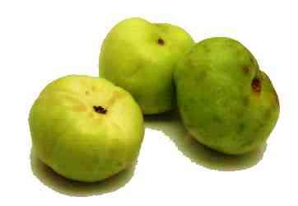
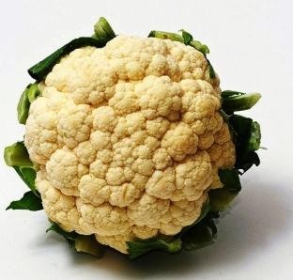
iule~~
dVgy
lqflEc%
Qjklchu
jDrkM~x%
VekVj
Ekwfydk] ewyde~
ewyh
fVafM’k%
fV.Mk
xksftg~ok%
Qwy xksHkh

Slide 9
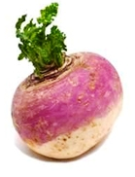
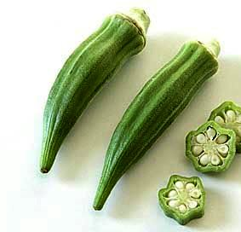
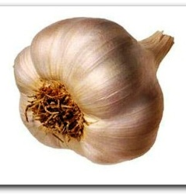
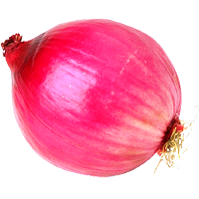
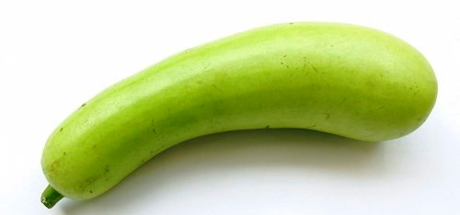
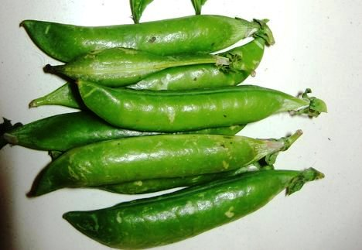
fHkMd%
fHkUMh
'osrdUn%
'kyt+e
y'kque~
yglqu
iyk.Mq%
I;kt+
dyk;%
eVj
vykcq%
ykSdh

Slide 10
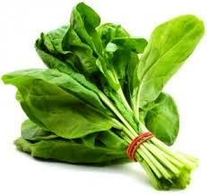
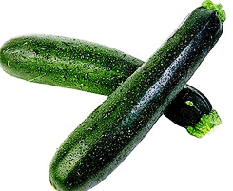
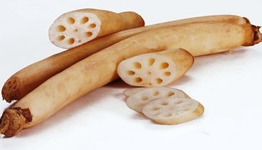
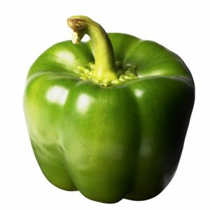
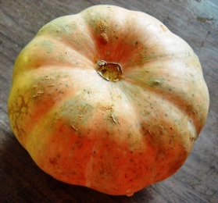
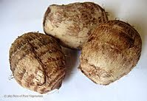
ikydh]ikyD;k
ikyd
Ek`.kky] fcl
Dey ddM+h
tkfyuh
rqjbZ
Dpkyq%
dpkyw
f’keyk ejhpe~
f’keyk fepZ
Dw"ek.M%
lhrkQy

Slide 11
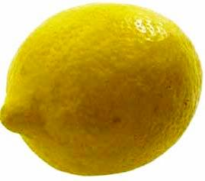
uhEcwde~
uhacw
Mk- dqeqnyrk ’kekZ

